Slide 1
Multi-View 2D Image-Based 3D
Modeling of Objects
GROUP 11
Jugal Vaghmashi [AU2340017]
Rena Malhotra [AU2340018]
Siya Dhaduk [AU2340022]
Jayvat Shah [AU2340027]

Slide 2
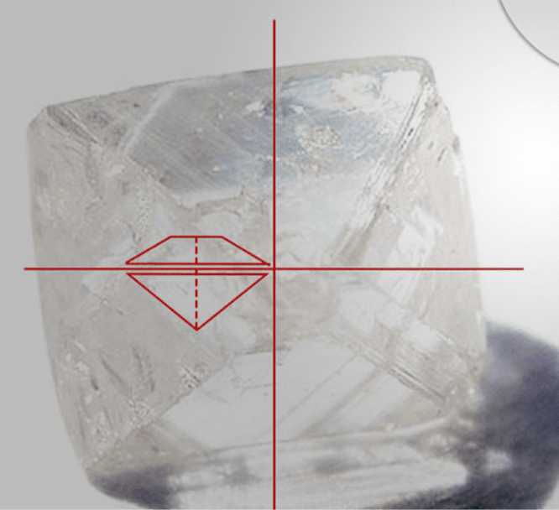
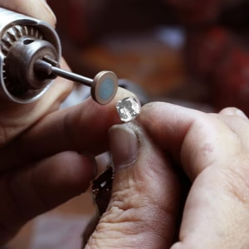
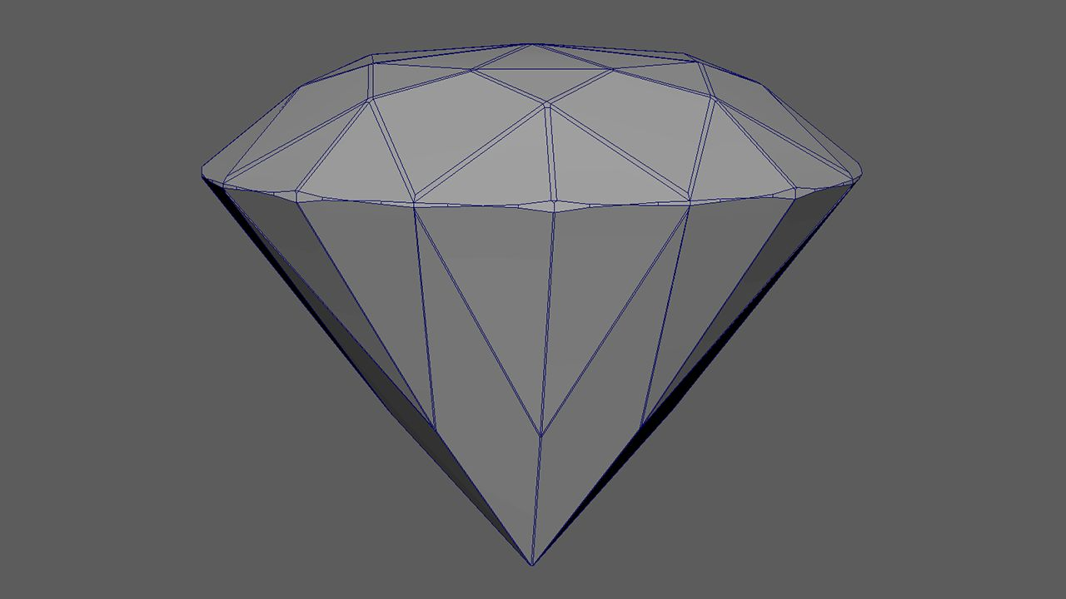
Introduction
Realistic 3D model generation from 2D images
Motivation: Diamonds’ precision geometry requires accurate 3D visualization
Aim: To reconstruct a 3D diamond stone model using multiple 2D silhouette projections
Applications: 3D modeling, virtual visualization, Reconciling for laser cutting

Slide 3
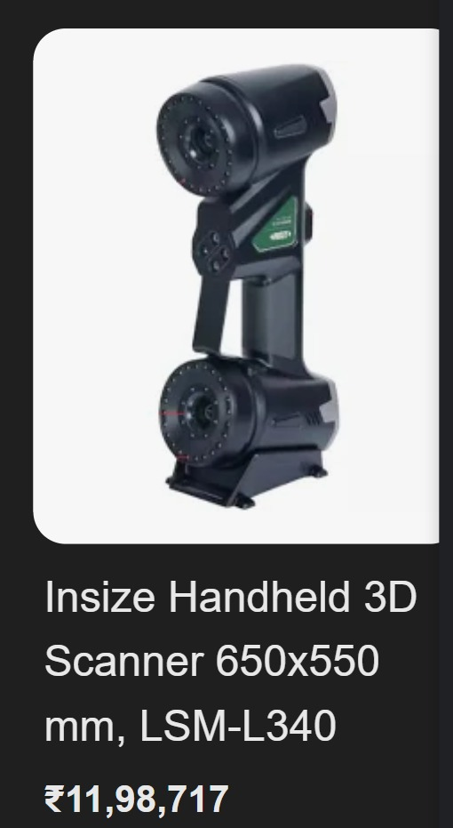
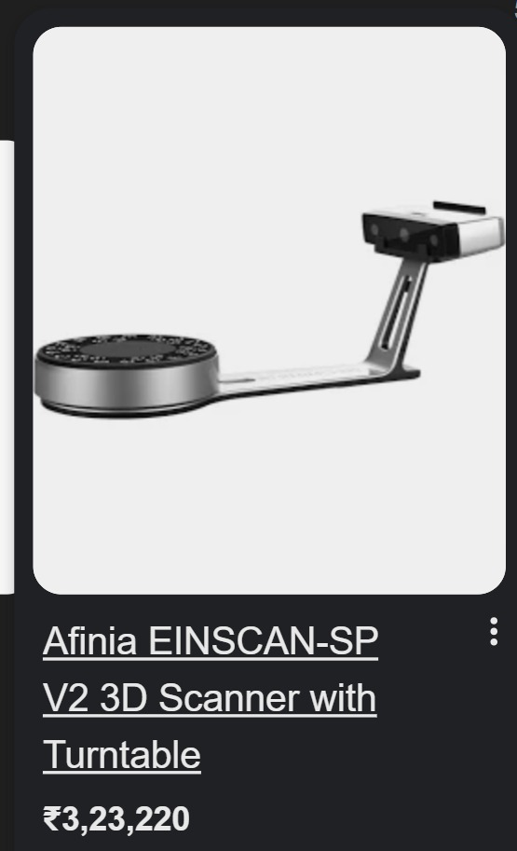
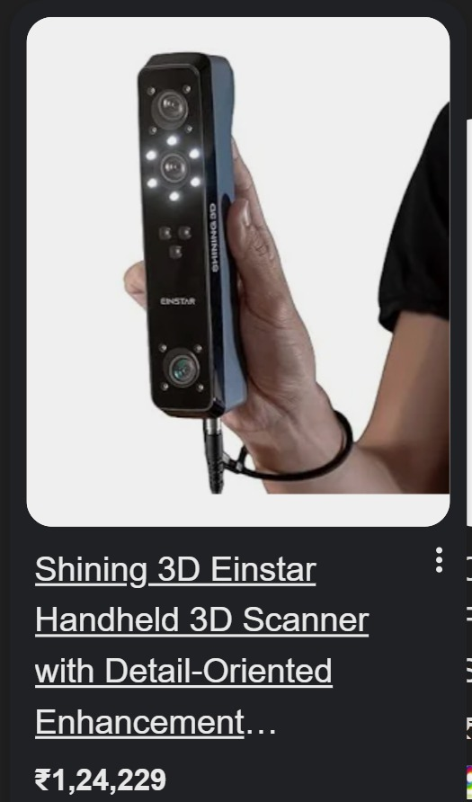

Slide 4
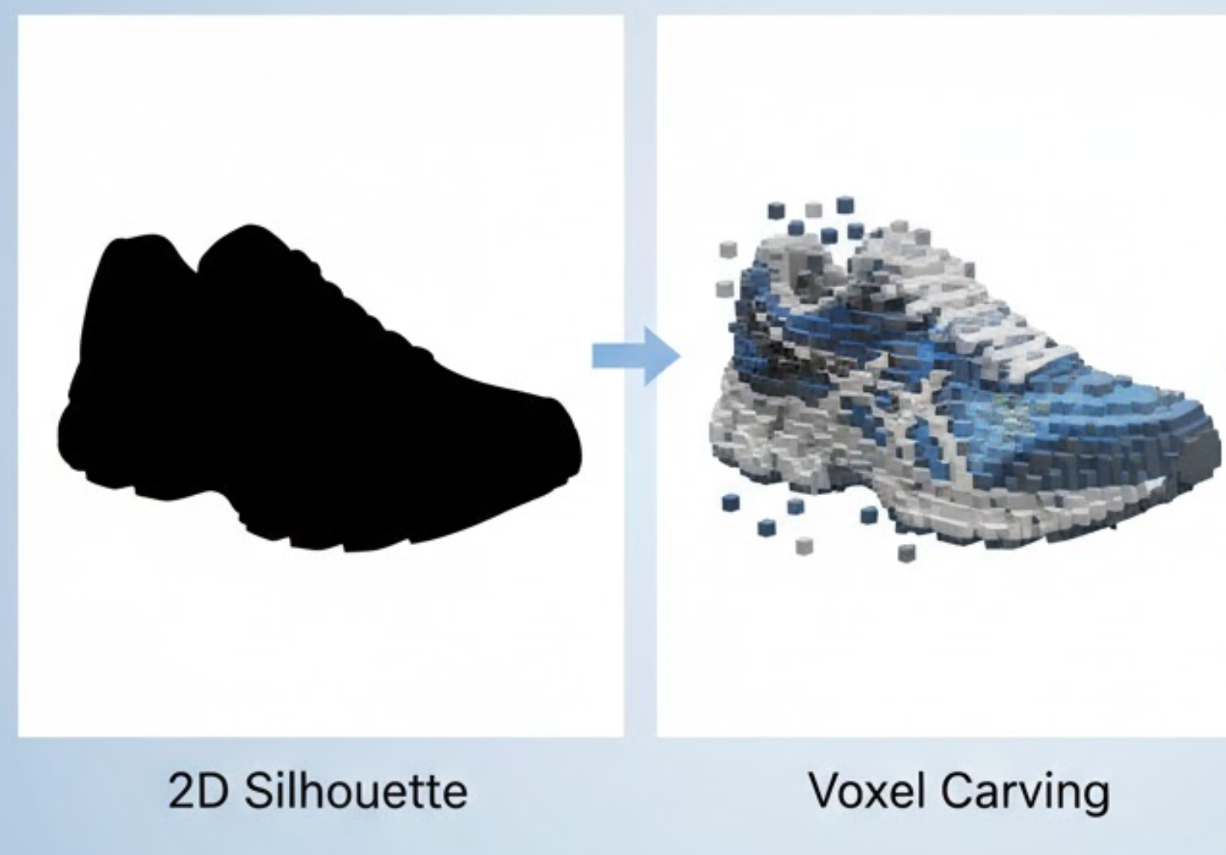
Literature Review
Previous works explored multi-view 3D reconstruction using image silhouettes.
ITM Conferences (2024) – Focused on voxel carving from silhouette images.
Our approach adapts these principles to diamond images for accurate 3D shape recovery.

Slide 5
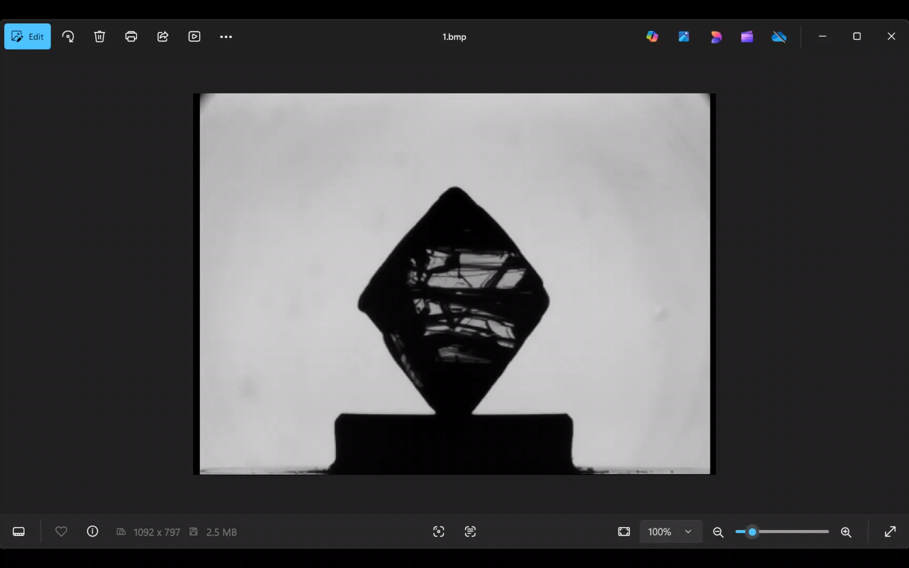
Dataset
200 images of a single diamond stone
Captured at 1.8° rotation difference per image
Format: BMP
Each image includes the diamond on a uniform background
Used for multi-angle projection and voxel carving

Slide 6
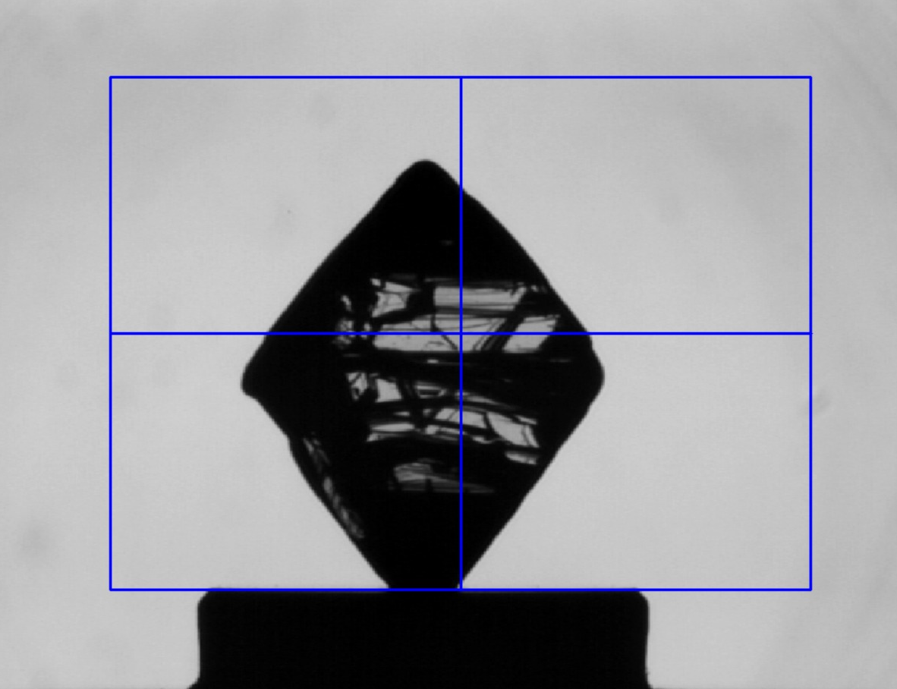
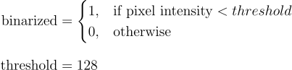
Methodology
Selection of diamond area
ROI SELECTION
2. CREATING CLEAN SILHOUETTE
Binarization
Gap Filling
Fill internal gaps for smooth shape.

Slide 7
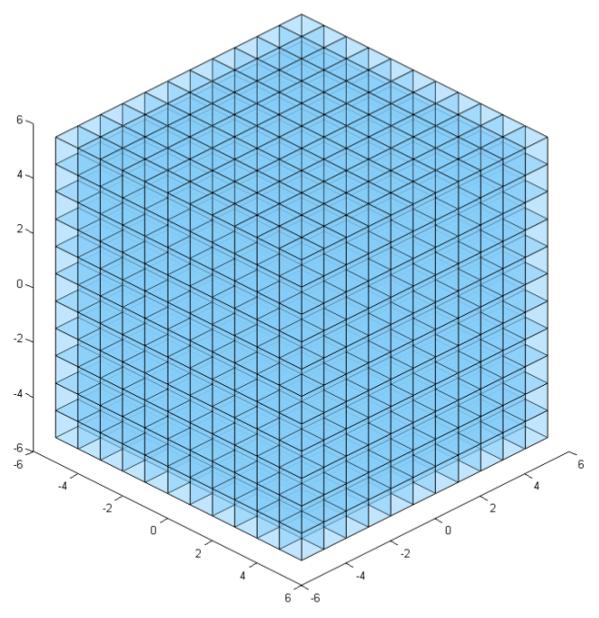
Methodology
Regular 3D voxel grid [1]
3. Voxel Grid Creation
Voxel (volume element) - 3D
equivalent of a pixel
Normalized 3D space for
analyzing 3D objects
[1] Regular 3D voxel grid—unoccupied. https://www.researchgate.net/publication/324389722/figure/fig3/AS:11431281391286952@1745321870314/Regular-3D-voxel-grid-unoccupied.tif

Slide 8

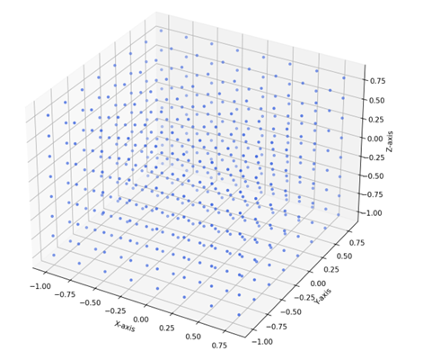
Results
Generated Silhouette
Voxel Grid

Slide 9
Conclusion
Successful Proof of concept: Generation of 2-D silhouette images.
Cost effective alternative: Cost effective instead of expensive commercial scanners & other devices.
Setting up of Voxel Grid: Normalized 3D voxel grid prepared for analysis and subsequent carving to approximate the visual hull.

Slide 10
Next Set of Work
Visual Hull : Implementing the 3D reconstruction algorithm by carving a voxel grid using the generated silhouettes.
Sphere Carving : Validating the concept of visual hull through a simulation.
Resolution Testing: Using different grid densities to analyze the output.
Autonomous Threshold: Replacing the manual thresholding in the binarization step with an automated algorithm.
Interactive Web UI Dashboard: Developing a web-interface for uploading images of the diamond and the final 3-D images generated.

Slide 11
References
[1] Regular 3D voxel grid—unoccupied. https://www.researchgate.net/publication/324389722/figure/fig3/AS:11431281391286952@1745321870314/Regular-3D-voxel-grid-unoccupied.tif

